Slide 1

Advance Your Research: Scale Out Your Computing
OSG User School 2023
August 7, 2023

Slide 2
Why Scale Out Your Computing?

Slide 3

Richard Ayoade in the IT Crowd, Series 1, Episode 2
https://giphy.com/gifs/richard-ayoade-it-crowd-maurice-moss-dbtDDSvWErdf2

Slide 4
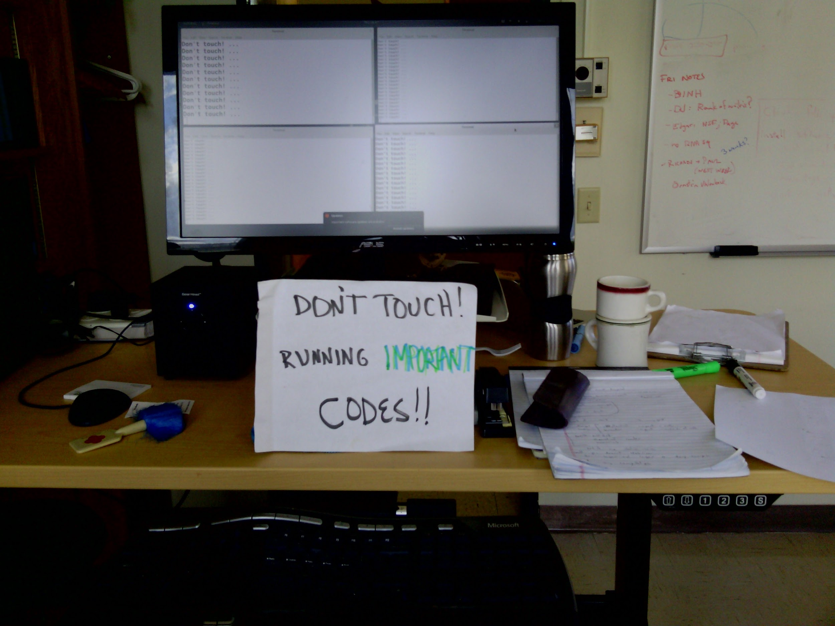
Photo credit Steve Goldstein

Slide 5
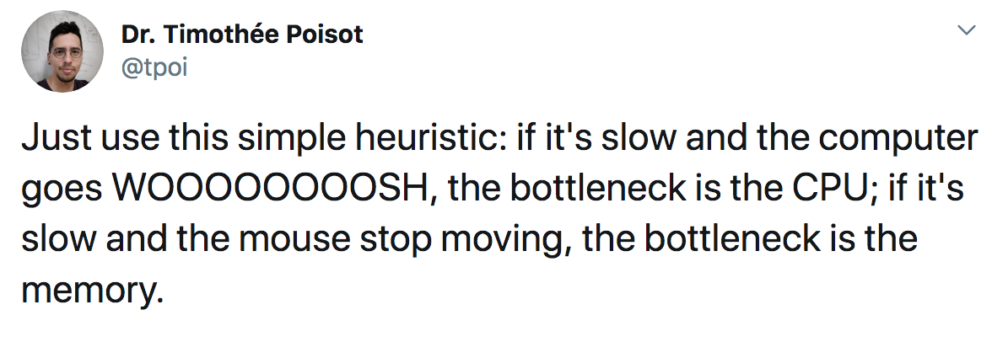
https://twitter.com/tpoi/status/1169692855201402885

Slide 6

Big Problems
Big problem
Big problem
How do you solve a big computational problem?
For example:
Lots of data
Thousands of parameters
Many grid points
😬??

Slide 7
Our Goal: Scaling Out
Big problem
Big problem
We want to be able to tackle big problems.
We want to go from using a small number of resources to a LOT of resources.
There is one strategy to do this with computers: divide and conquer
😎
X 1000s!

Slide 8
Big Solutions
Big problem
To solve a big problem, break it into many sub-problems and use more/specialized computers.
There are different ways to do this.

Slide 9
Large Scale Computing Approaches

Slide 10
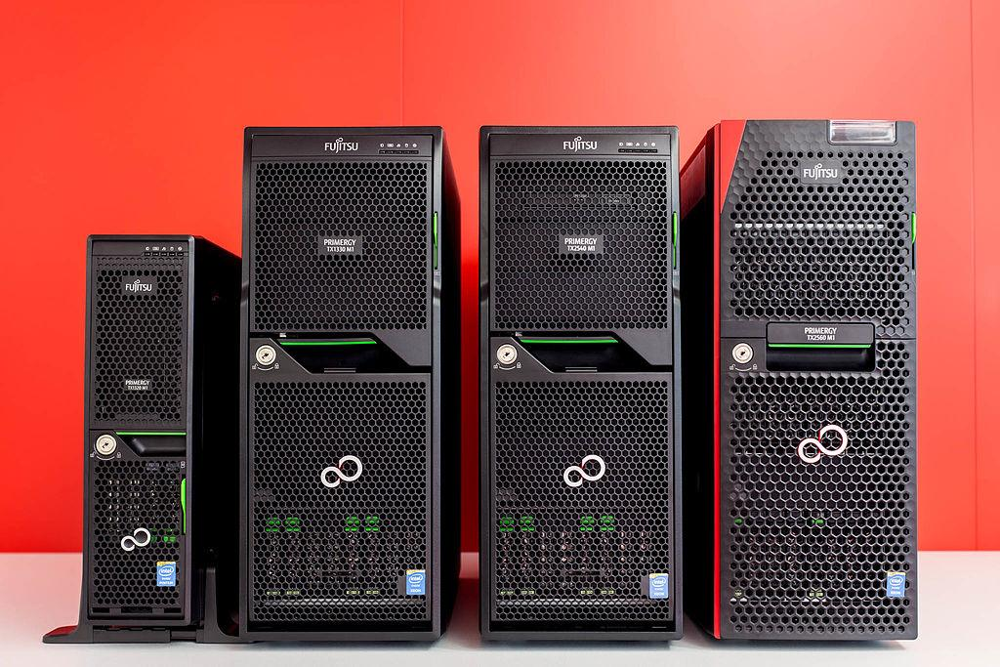
A bigger computer
Sometimes, getting a larger computer can solve your problem - more CPUs, more memory, more disk space.
Workstation
Server that requires remote log in
Trique303 [CC BY-SA 4.0 (https://creativecommons.org/licenses/by-sa/4.0)]

Slide 11
Option 1: More CPUs
Big problem
Run sub-problems on individual CPUs.
Requires programming this capability into the code.
← 12 CPUs

Slide 12
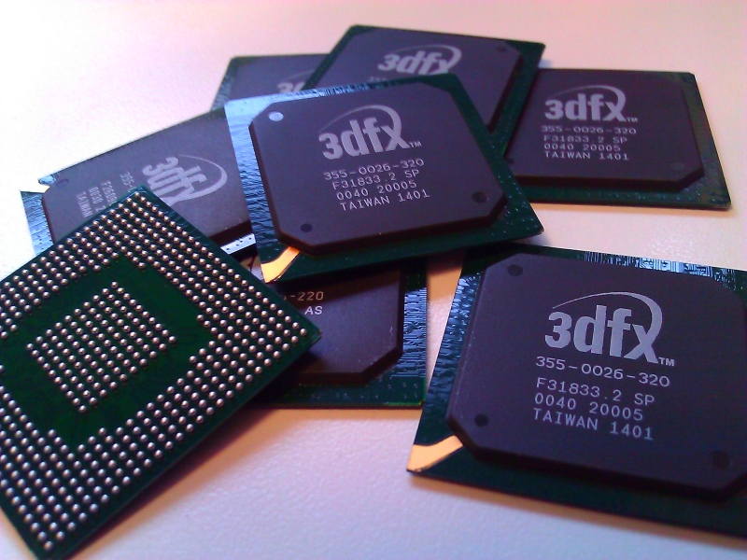
Specialized computer components (like GPUs)
GPUs are a common way to accelerate certain kinds of computing.
Like before, can be used from a:
Workstation
Server
Trique303 [CC BY-SA 4.0 (https://creativecommons.org/licenses/by-sa/4.0)]

Slide 13
Option 2: Use a GPU
Big problem
Run sub-problems on “cores” inside a GPU card.
Like before, requires programming this capability into the code.
Examples:
Neural networks and other deep learning algorithms
Certain molecular dynamic codes
← GPU with 100s
of “cores”

Slide 14
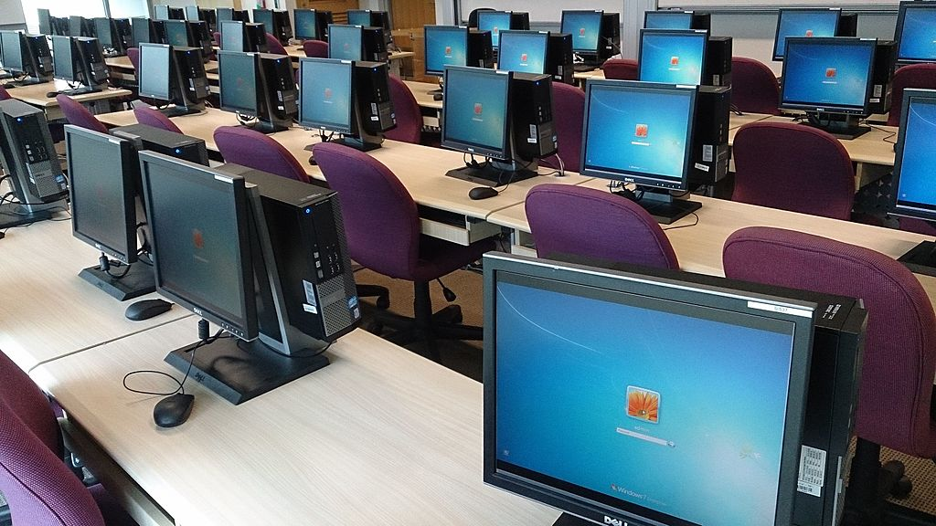
Use more computers at once.
This is the idea behind the large-scale computing systems like the Open Science Pool.
ProjectManhattan [CC BY-SA 3.0 (https://creativecommons.org/licenses/by-sa/3.0)]

Slide 15
Option 3: High Performance Computing (HPC)
Solve sub-problems by distributing across multiple CPUs on multiple computers.
Also requires special coding (MPI) to coordinate calculations across multiple computers.
n interdependent* processors
1
2
3
...
n
time

Slide 16
HPC Examples:
Complex physical simulations with many inter-connected components.
Optimization problems that use many local calculations to drive the global optimization.

Slide 17
Option 4: High Throughput Computing (HTC)
Sub-problems are independent and self-contained, can be run on many computers.
Most scalable.
No special programming needed.
n independent* processors
1
2
3
...
n
time

Slide 18
HTC Examples:
Test many parameter combinations
Analyze multiple images or datasets
Do a replicate/randomized analysis
Align genome/RNA sequence data

Slide 19
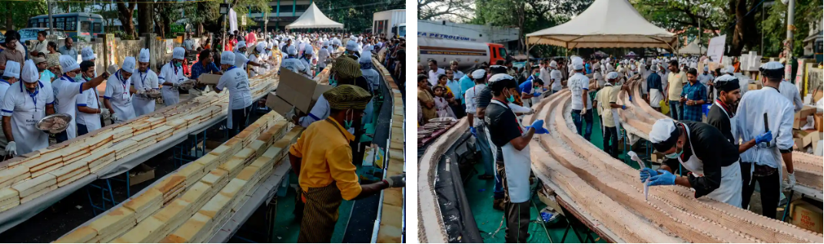
One of our favorite HTC examples: baking the world’s largest/longest cake
In computational terms: solving a big problem (the world’s longest cake) by executing many small, self-contained tasks (individual cakes) and joining them.
Photos: Arun Sankar via https://www.theguardian.com/world/2020/jan/16/indian-bakers-rise-to-task-of-making-worlds-longest-cake

Slide 20
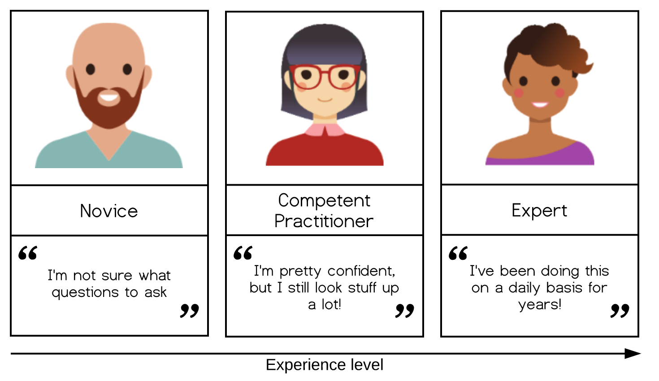
Three Researchers
Mei Monte Carlo
Needs to run many random simulations to estimate a statistical value.
Ben Bioinformatics
Needs to process 100s of genomic data files.
Tamara Trials
Needs to test the performance of a machine learning model with many (hyper)parameters.

Slide 21
Use Case 1: Random Simulations
Typical task: running a simulation
One computation needs:
1 core, 512Mb of memory
almost no data
10 seconds
How many times? Millions
Are there multiple steps involved? No.
Bottleneck: total number of simulations
Mei Monte Carlo
Needs to run many random simulations to estimate a statistical value.

Slide 22
Use Case 2: Analyzing Multiple Files
Typical task: analyzing a data sample
One computation needs:
1-16 cores, 8 – 32GB of memory
Input of 5GB, output of 10GB
8-10 hours for whole pipeline
How many times? Dozens (number of samples)
Are there multiple steps involved? Yes.
Bottleneck: Size of data, number of samples, certain steps
Ben Bioinformatics
Needs to process 100s of genomic data files.

Slide 23
Use Case 3: Different Parameters
Typical task: training and testing a machine learning model
One computation needs:
4 cores, 1 GPU, 12Gb of memory
Input of 3GB, output of 1GB
6 hours
How many times? About 10 a day
Are there multiple steps involved? Not really.
Bottleneck: Length of training/testing cycle,
Tamara Trials
Needs to test the performance of a machine learning model with many (hyper)parameters.

Slide 24
Discussion
See handout.
Notes:
https://docs.google.com/presentation/d/1_7d-qW7uRV-lPJ9iYqt8JPVacXYkY0k_aocoFzwXlzY/edit#slide=id.p

Slide 25
OSG School = HTC School
This week is all about learning more about the practice of high throughput computing:
Job submission + troubleshooting (Mon/Tues)
Software portability (Tues)
Data handling (Wed)
On two different high throughput computing resources
The PATh Facility (Mon)
the Open Science Pool (Tues onward)

Slide 26
Acknowledgements
This material is based upon work supported by the National Science Foundation under Grant No. 2030508. Any opinions, findings, and conclusions or recommendations expressed in this material are those of the author(s) and do not necessarily reflect the views of the National Science Foundation.

